Slide 1

Bioinformatics analysis of the genes involved in the extension of prostate cancer to adjacent lymph nodes by supervised and unsupervised machine learning methods: The role of SPAG1 and PLEKHF2
BINF 702 – Ian Bates

Slide 2
Purpose
Analysis of TCGA Dataset of Prostate Adenocarcinoma
Prostate cancer is incredibly common in the United States
Outside of skin cancer, this cancer is the most frequently diagnosed cancer in the United States
It has been estimated that about 9% of prostate cancers can be attributed to heredity
Prostate-Specific Antigen (PSA) – Current Testing
PSA testing has a high false positives rates due
Goal: determine candidate genes to serve as markers for metastatic prostate cancers

Slide 3
cBioPortal
Prostate Adenocarcinoma (TCGA, PanCancer Atlas)
> study.all_data
A MultiAssayExperiment object of 14 listed
experiments with user-defined names and respective classes.
Containing an ExperimentList class object of length 14:
[1] armlevel_cna: SummarizedExperiment with 39 rows and 494 columns
[2] cna: SummarizedExperiment with 25128 rows and 489 columns
[3] cna_hg19.seg: RaggedExperiment with 75618 rows and 489 columns
[4] log2_cna: SummarizedExperiment with 25128 rows and 489 columns
[5] microbiome: SummarizedExperiment with 1406 rows and 492 columns
[6] mrna_seq_v2_rsem: SummarizedExperiment with 20531 rows and 493 columns
[7] mrna_seq_v2_rsem_zscores_ref_all_samples: SummarizedExperiment with 20531 rows and 493 columns
[8] mrna_seq_v2_rsem_zscores_ref_diploid_samples: SummarizedExperiment with 20471 rows and 493 columns
[9] mrna_seq_v2_rsem_zscores_ref_normal_samples: SummarizedExperiment with 20531 rows and 493 columns
[10] mutations: RaggedExperiment with 34192 rows and 493 columns
[11] rppa: SummarizedExperiment with 198 rows and 350 columns
[12] rppa_zscores: SummarizedExperiment with 198 rows and 350 columns
[13] mrna_seq_v2_rsem_normal_samples: SummarizedExperiment with 20531 rows and 52 columns
[14] mrna_seq_v2_rsem_normal_samples_zscores_ref_normal_samples: SummarizedExperiment with 20531 rows and 52 columns
Functionality:
experiments() - obtain the ExperimentList instance
colData() - the primary/phenotype DataFrame
sampleMap() - the sample coordination DataFrame
`$`, `[`, `[[` - extract colData columns, subset, or experiment
*Format() - convert into a long or wide DataFrame
assays() - convert ExperimentList to a SimpleList of matrices
exportClass() - save data to flat files

Slide 4
mRNA samples
mrna_seq_v2_rsem_zscores_ref_diploid_samples
> mrna_subset
A MultiAssayExperiment object of 1 listed
experiment with a user-defined name and respective class.
Containing an ExperimentList class object of length 1:
[1] mrna: SummarizedExperiment with 20471 rows and 493 columns
Functionality:
experiments() - obtain the ExperimentList instance
colData() - the primary/phenotype DataFrame
sampleMap() - the sample coordination DataFrame
`$`, `[`, `[[` - extract colData columns, subset, or experiment
*Format() - convert into a long or wide DataFrame
assays() - convert ExperimentList to a SimpleList of matrices
exportClass() - save data to flat files
Challenges:
Conversion between datatypes: MultiAssayExperiment to useable format
ExpressionSet (same as ALL)
Ensure this was the same as was used in the study

Slide 5
Data Pipeline
Raw ExpressionSet
(20,471 gene expressions 493 Patients)
> table(mrna$PATH_N_STAGE)
N0 N1
342 78
Remove All 0’s and impute means
Clean ExpressionSet
(19,965 gene expressions 420 Patients)

Slide 6
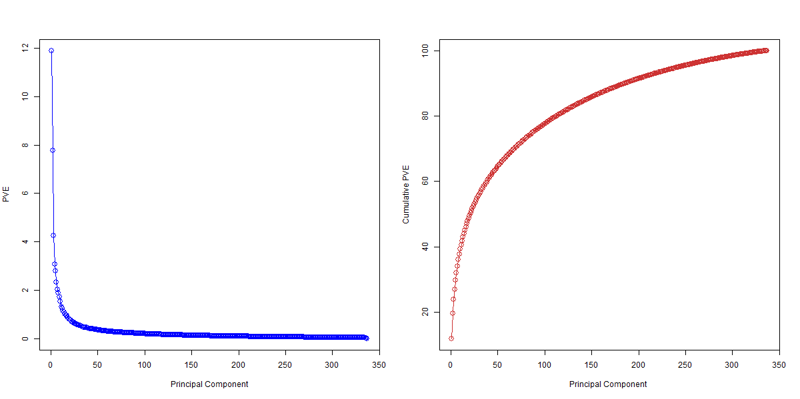
PCA
> pr.out=prcomp(t(exprs(mrna.train)) , scale=TRUE)

Slide 7
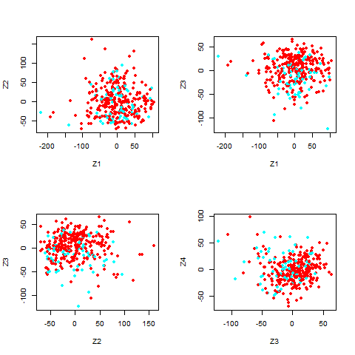
PCA (cont)
> pr.out=prcomp(t(exprs(mrna.train)) , scale=TRUE)

Slide 8
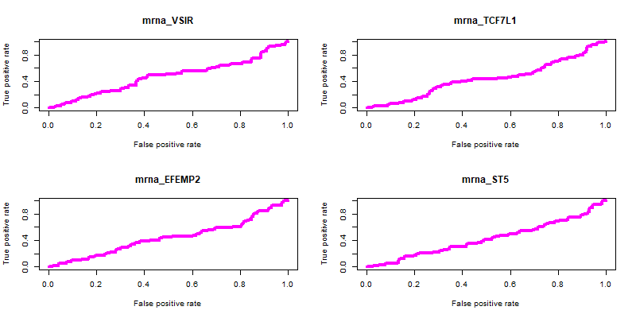
PCA (cont)
pred <- prediction(t(exprs(mrna.train[top_50_pc2[i],])), mrna.train$PATH_N_STAGE)

Slide 9
ANOVA Feature Reduction
> anova.pValue <- apply(exprs(mrna.train), 1, function(x) anova(lm(x ~ +mrna.train$PATH_N_STAGE))$Pr[1])
> sum(anova.pValue<0.05)
[1] 4298

Slide 10
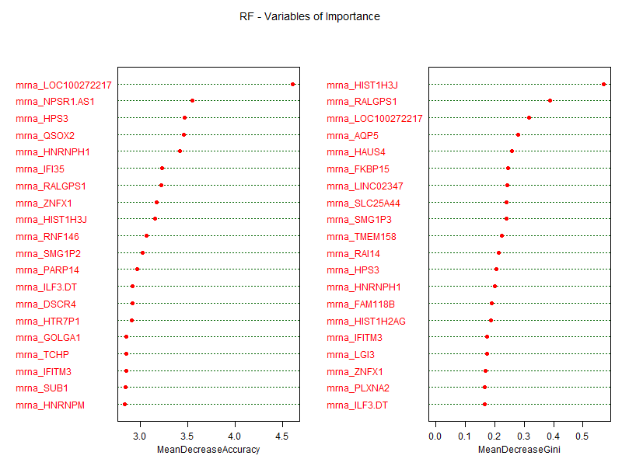
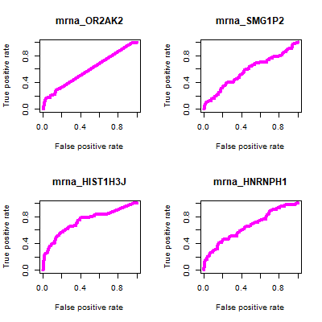
Random Forrest - Probe
> library(randomForest)
> Y <- factor(mrnaSp$PATH_N_STAGE);
> X <- t(probeData) #matrix form of ANOVA Feature Reduction
> rf1 <- randomForest(X, Y, ntree = 1000, importance=TRUE, proximity=TRUE)
> rf1$confusion
N0 N1 class.error
N0 269 5 0.01824818
N1 53 10 0.84126984

Slide 11
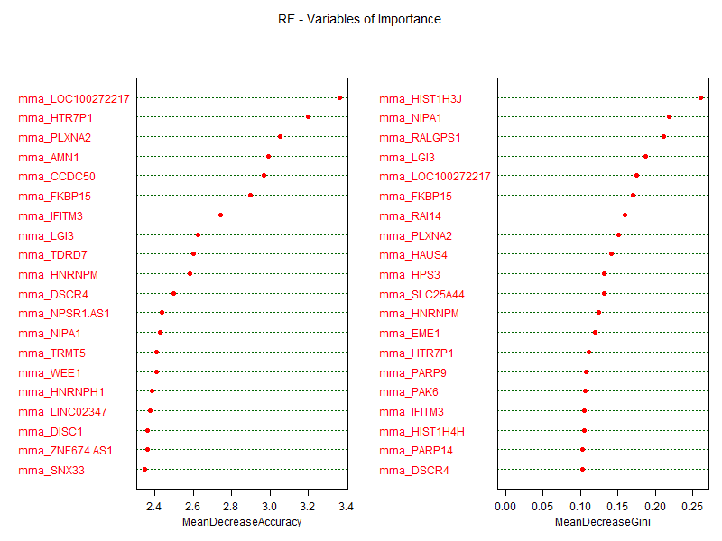
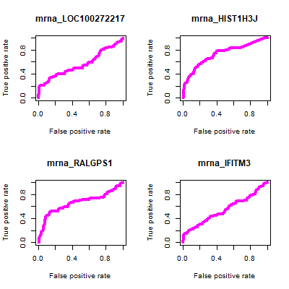
Random Forrest - ALL
> library(randomForest)
> Y <- factor(mrna.train$PATH_N_STAGE);
> X <- t(probeData) #matrix form of non-reduced features
> rf1 <- randomForest(X, Y, ntree = 1000, importance=TRUE, proximity=TRUE)
>most_important[1:10]
[1] "mrna_OR2AK2" "mrna_SMG1P2" "mrna_HIST1H3J" "mrna_HNRNPH1" "mrna_LINC02347"
[6] "mrna_RPS26" "mrna_AQP5" "mrna_B3GAT1" "mrna_HDDC2" "mrna_KIF1A"

Slide 12
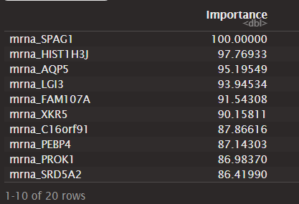
Naïve Bayes – ANOVA subset
>X <- t(exprs(mrnaSp))
>Y <- mrnaSp$PATH_N_STAGE
>Grid = data.frame(usekernel = TRUE,
+ laplace = 0,
+ adjust = 1)
>train_control <- trainControl(method = "cv",
+ number = 3)
>mdl = nb.m1 <- train(
> + x = t(exprs(mrnaSp)),
> + y = mrnaSp$PATH_N_STAGE,
> + method = "nb",
> + trControl = train_control)
>confusionMatrix(mdl
>confusionMatrix(mdl)
Cross-Validated (3 fold) Confusion Matrix
(entries are percentual average cell counts across resamples)
Reference
Prediction N0 N1
N0 73.3 9.5
N1 8.0 9.2
Accuracy (average) : 0.8249
> varImp(mdl)
ROC curve variable importance
only 20 most important variables shown (out of 4298)

Slide 13
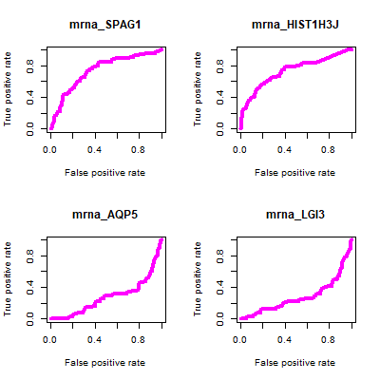
Naïve Bayes – ANOVA subset

Slide 14
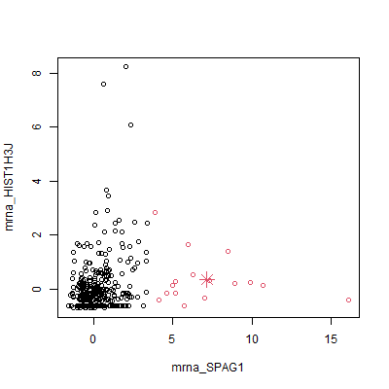
Kmeans Clustering from NB VarIMP

Slide 15
Remaining work
Review the PCA
Evaluate the tuning of the random forest models (poor predicting qualities)
Evaluating clustering of other variables

